Slide 1
Telecom Churn Case study

Slide 2
Problem Statement
In the telecom industry, customers are able to choose from multiple service providers and actively switch from one operator to another.
The telecommunications industry experiences an average of 15-25% annual churn rate.
Customer retention has now become even more important than customer acquisition.
Churn prediction is usually more critical (and non-trivial) for prepaid customers.

Slide 3
Business Goal
Analyze customer-level data of a leading telecom firm, build predictive models to identify customers at high risk of churn and identify the main indicators of churn.
Retaining high profitable customers is the number one business goal.
Predict which customers are at high risk of churn.

Slide 4
Strategy
Source the data for analysis
Clean and prepare the date
Exploratory Data Analysis
Feature Scaling
Splitting the data into Test and Train Data Set
Building the Logistic Regression Model
identify important variables that are strong predictors of churn.

Slide 5
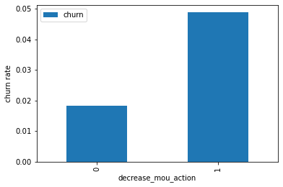
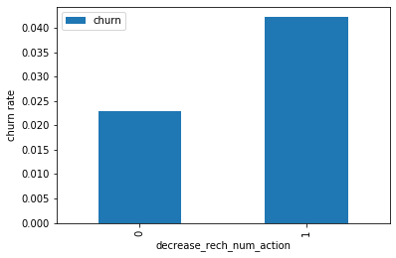
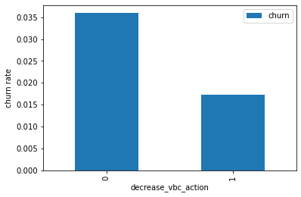
Exploratory Data Analysis
The churn rate is more for the customers, whose number of recharge in the action phase is lesser than the number in good phase.
the churn rate is more for the customers, whose minutes of usage(mou) decreased in the action phase than the good phase.
The churn rate is more for the customers, whose volume-based cost in action month is increased.

Slide 6
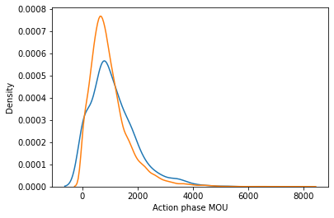
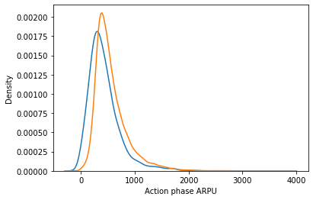
The higher Average Revenue Per User (ARPU) customers are less likely to be churned.
Higher the Minutes of Usage (MOU), lesser the churn probability.

Slide 7
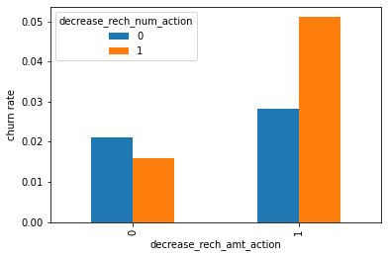
The churn rate is more for the customers, whose recharge amount as well as number of recharge have decreased in the action phase than the good phase.

Slide 8
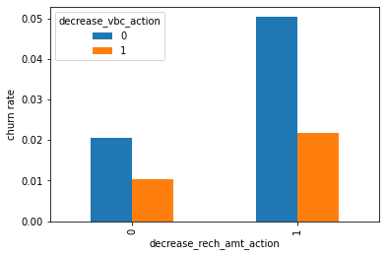
The churn rate is more for the customers, whose recharge amount is decreased along with the volume-based cost is increased in the action month.

Slide 9
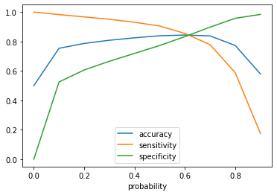
Accuracy - Becomes stable around 0.6
Sensitivity - Decreases with the increased probability.
Specificity - Increases with the increasing probability.

Slide 10
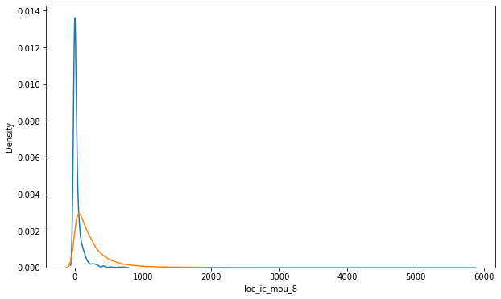
The churn customers the minutes of usage for the month of August is mostly populated on the lower side than the non churn customers.

Slide 11
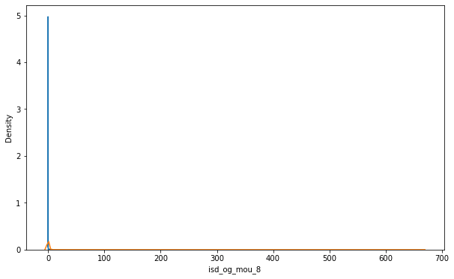
The ISD outgoing minutes of usage for the month of August for churn customers is dense approximately to zero. On the on ther hand for the non churn customers it is little more than the churn customers.

Slide 12
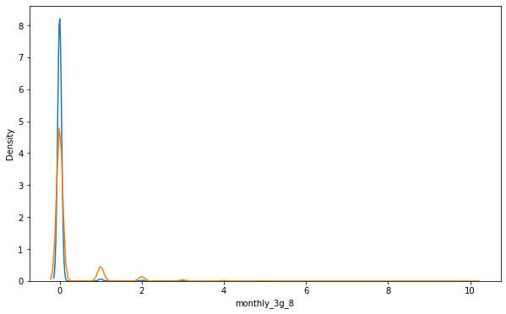
The number of mothly 3g data for August for the churn customers are very much populated aroud 1, whereas of non churn customers it spreaded accross various numbers.

Slide 13
The following are the strongest indicators of churn:
Customers who churn show lower average monthly local incoming calls , compared to users who don't churn .
Customers who churn show lower number of recharges done in action period.
Customers who churn are more likely to be users of 'monthly 2g package-0 / monthly 3g package-0' in action period.

